Slide 1
Reporting
Group 6

Slide 2

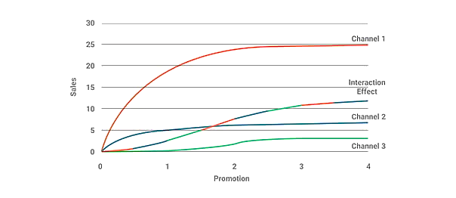





What is Reporting ?
The means and measure used to collect, process, store and present information within an organization
Sales Report
Field Report
Market Access Report
(Market Mix Analysis of A Top US Pharma Company)¹
Marketing Report
Patient Insights
Compliance Report
Types
Example

Slide 3


Why Reporting?
Objectives
Business Needs
Monitor Sales & Marketing Effectiveness
Track KPIs to measure performance accountability
Ensure Compliance with Industry Regulations
Provide data-driven insights to enhance transparency
Enable Data Driven Strategic Decision making
Enable quick response to market & competitor changes

Slide 4

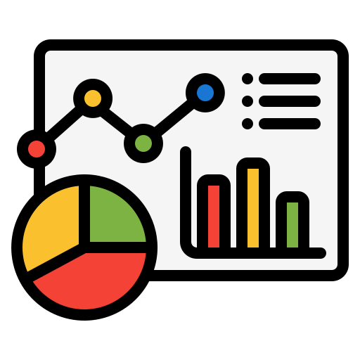
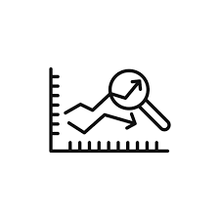


How? Approaches and Methods
Methods
Descriptive : Analyzes past data to understand trends
Approaches
Standard dashboards
for consistent reporting
Predictive : Uses historical data to forecast future outcomes
Automation Tools like Power BI for real-time insights
AI/ML : Detect patterns and enhance targeting precision

